Slide 1
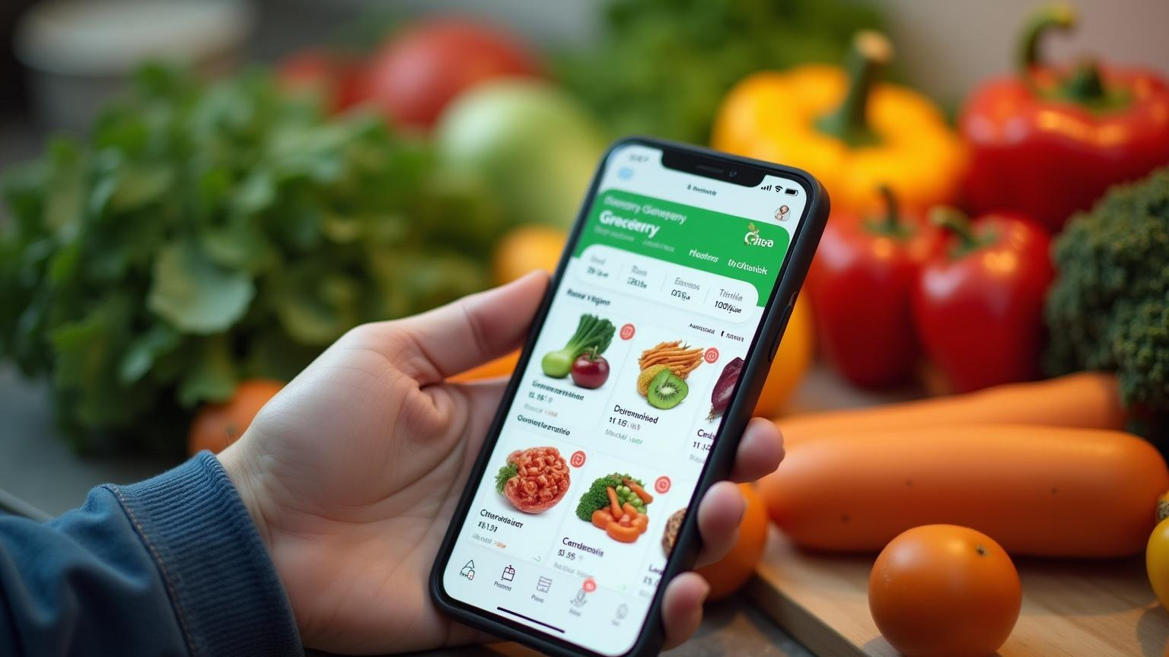
Digital Grocery Store App

Slide 2
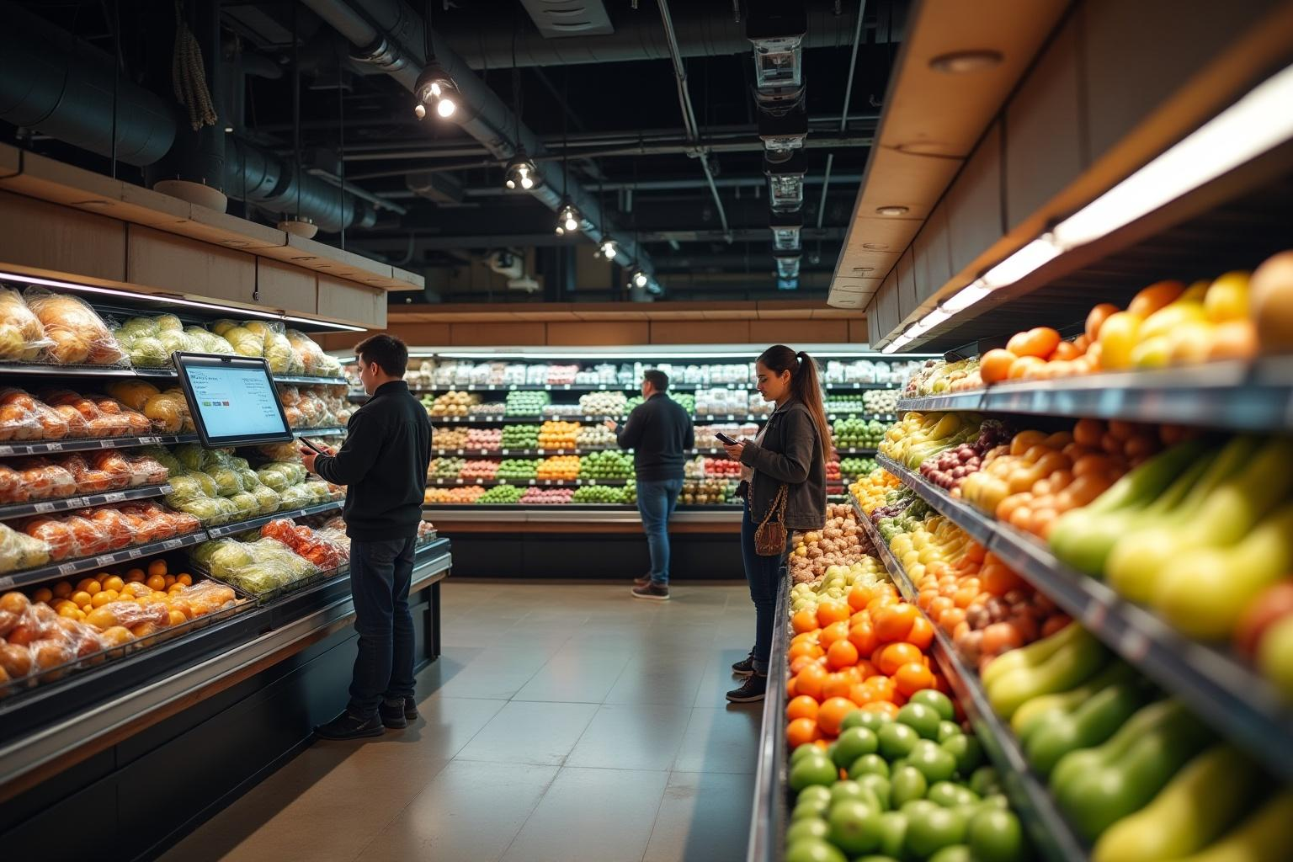
Introduction
This presentation explores the digital grocery store app landscape, focusing on market trends and key features that enhance user experience. The digital shift in grocery shopping has gained momentum, leading to innovative solutions that meet consumer needs.

Slide 3
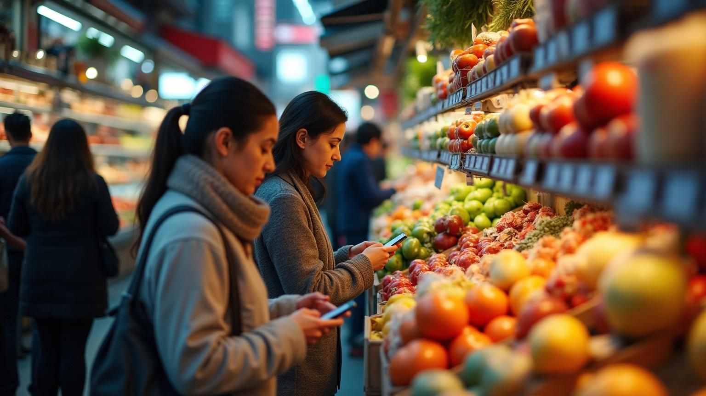
Market Overview
01

Slide 4
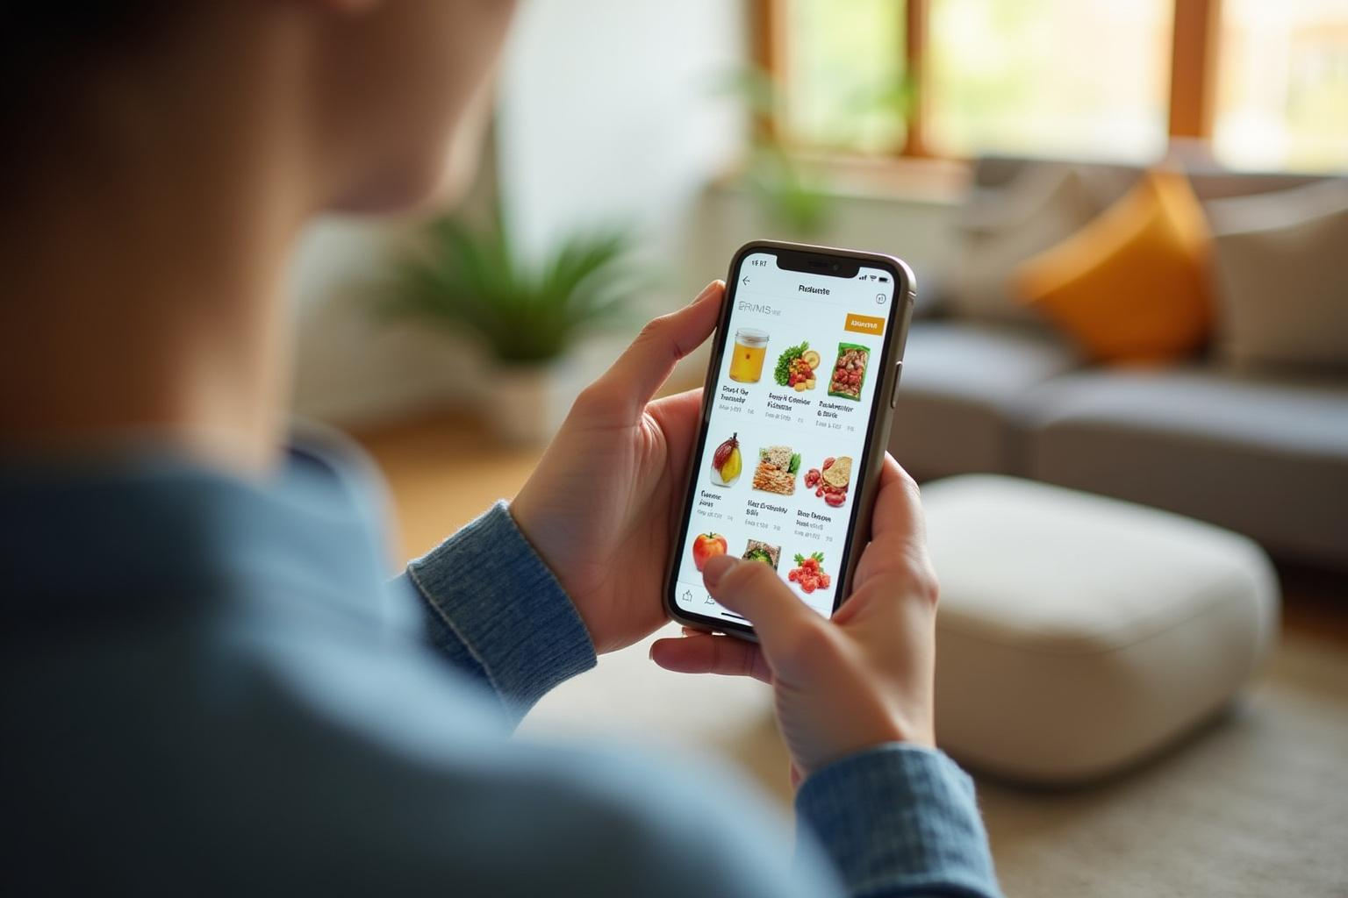
Current trends in grocery shopping
Consumers are increasingly opting for online grocery shopping due to convenience and time-saving benefits. The rise of mobile apps has changed the traditional shopping experience, allowing shoppers to browse, compare, and purchase groceries from their devices.

Slide 5
Growth of online grocery apps
The online grocery app market has seen significant growth, fueled by changing consumer preferences and advancements in technology. More people are now relying on these apps for their daily grocery needs, resulting in increased competition among providers.

Slide 6
Consumer behavior insights
Understanding consumer behavior is crucial for the success of digital grocery apps. Shoppers prioritize convenience, variety, and pricing. Mobile access and personalized recommendations significantly influence purchasing decisions, leading to increased loyalty and platform utilization.

Slide 7
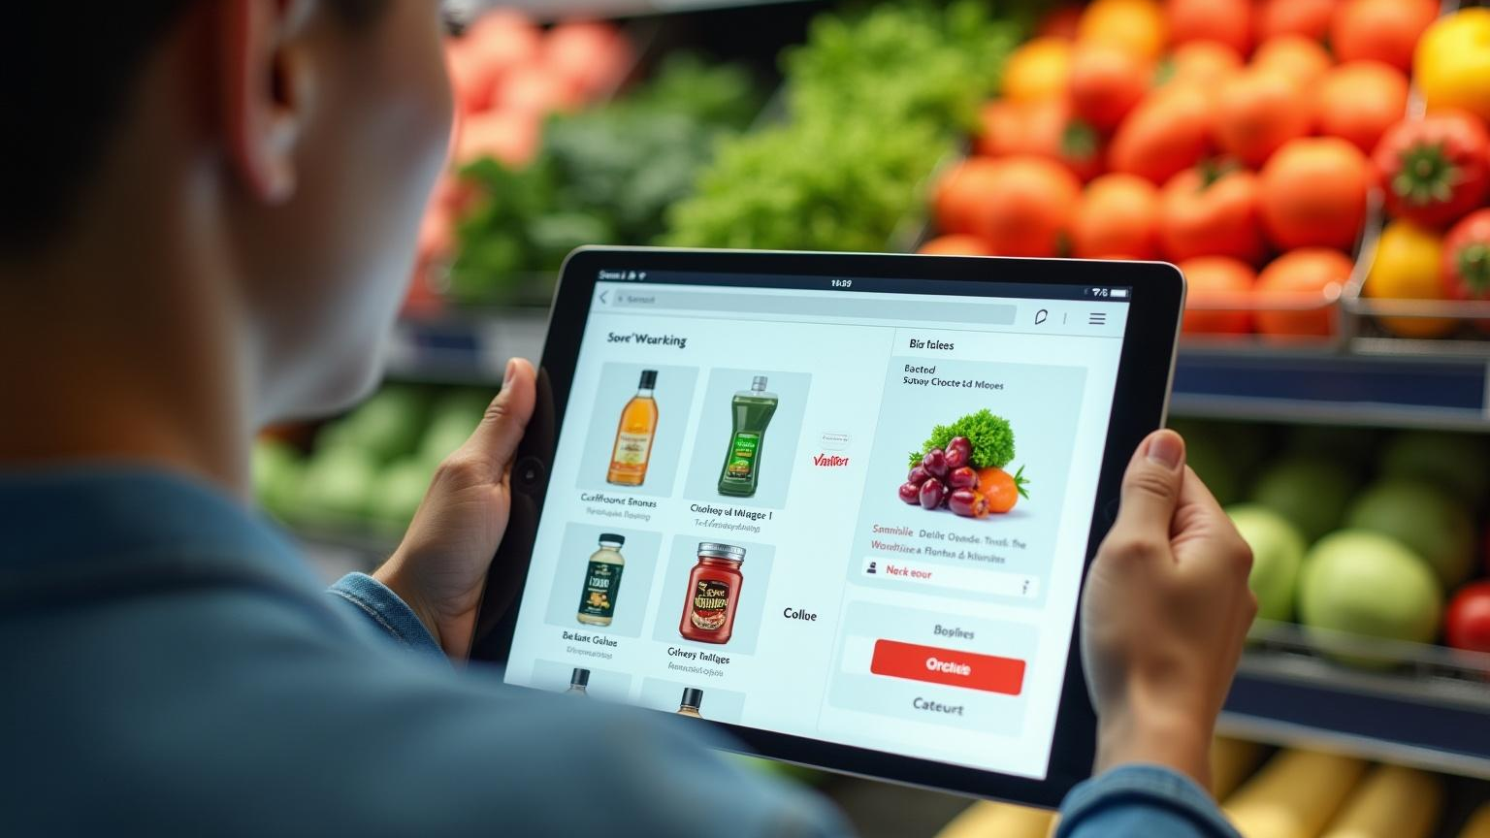
App Features
02

Slide 8
User-friendly interface
A user-friendly interface is essential for any digital grocery app. It should enable easy navigation, product search, and order placement. Well-structured categories and intuitive design enhance the shopping experience, encouraging users to explore and make purchases.

Slide 9
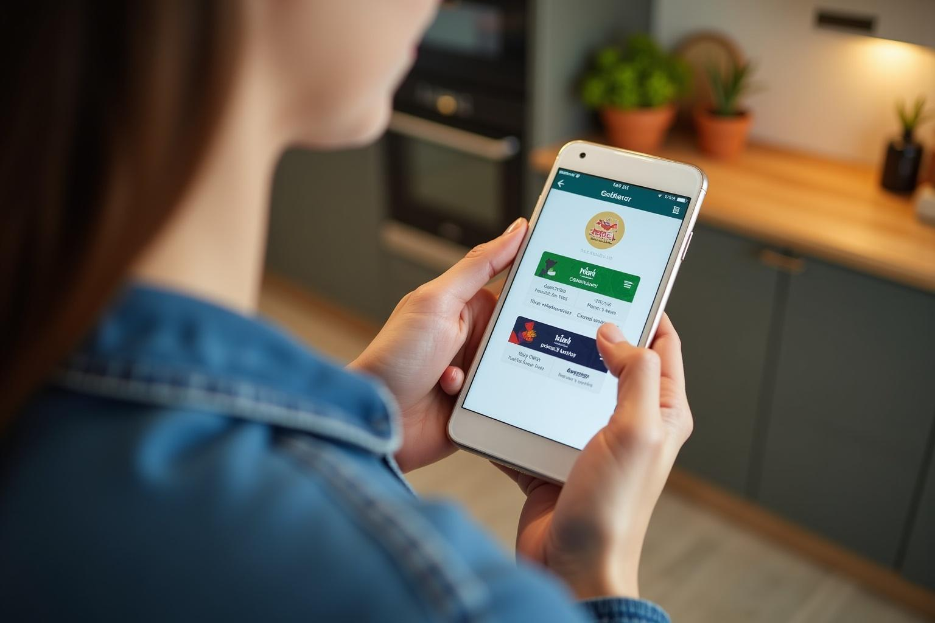
Payment and delivery options
Offering a variety of payment options, such as credit cards, digital wallets, and cash on delivery, improves consumer satisfaction. Additionally, flexible delivery options, including same-day and scheduled deliveries, accommodate diverse consumer preferences and enhance convenience.

Slide 10
Inventory management and analytics
Effective inventory management is key to ensuring product availability and minimizing waste. Incorporating analytics tools allows app operators to track consumer preferences, forecast demand, and adjust stock levels accordingly, improving operational efficiency.

Slide 11
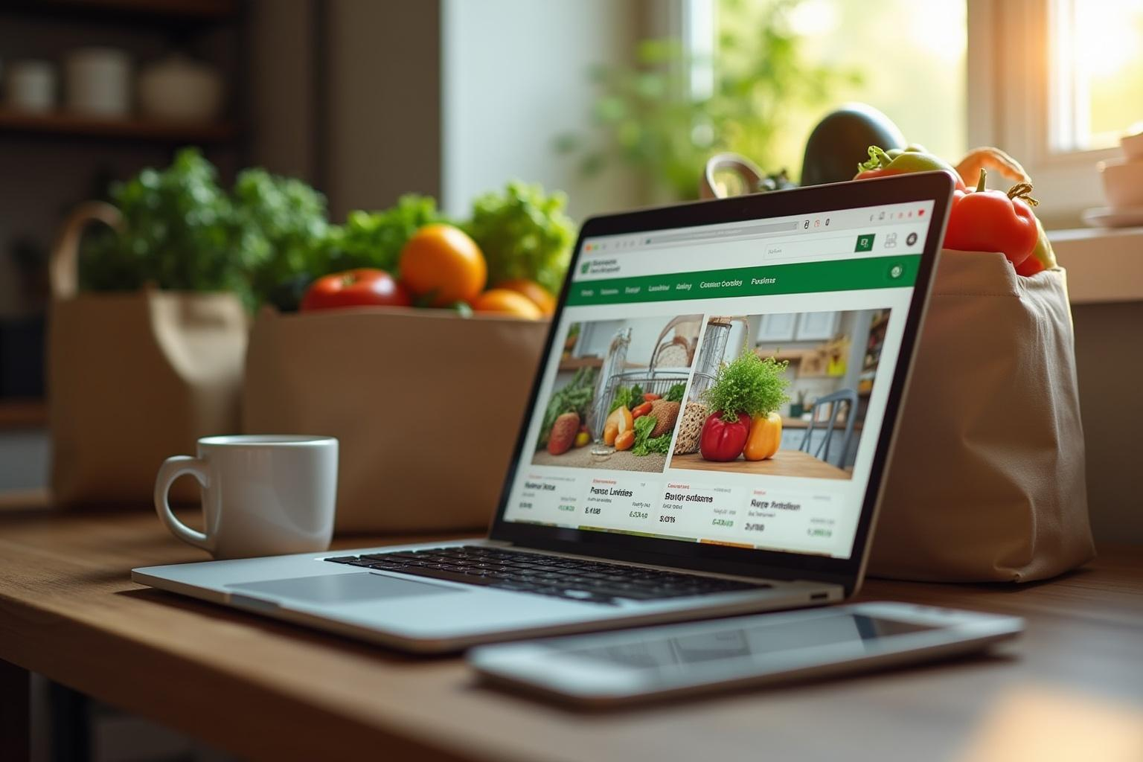
Conclusions
In conclusion, the success of a digital grocery store app hinges on understanding consumer behavior and incorporating essential features. By prioritizing user experience, offering flexible payment and delivery options, and leveraging inventory management tools, providers can drive engagement and growth in this competitive market.

Slide 12
Thank you!

